Slide 1
Name____________________________________ Date____________________
Post Module 5 – Classwork Review
Show 3 x ⅖ . (NF.4) 2. Show 6 x ⅕. (NF.4)
3. Explain using words, models, and/or numbers why 3 x ⅖ = 6 x ⅕. (NF.4)
Fill in the circles below with <, =, or > to make true number sentences. Justify your answer. (NF.2)
4.
21
4
2
5
5
5.
22 5
2
7
5
6.
29
8
11 3

Slide 2
Find each sum or difference. (NF.3)
7.
2
7
7
8
8.
4
5
3
5
5
+
3
+
9.
5
6
4
6
10.
5
8
7
8
10
-
12
-
3
11.
4
5
Solve 2 x . (NF.4)
1
2
12.
Solve 3 x 4 . (NF.4)

Slide 3
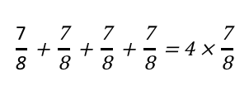
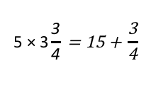
Determine if the following are true or false. Explain how you know using models or words. Make false problems true by rewriting the right side of the number sentence.
13. (NF.3)
14. (NF.3)
15. (NF.3)
16. (NF.3)
17.
(NF.4)
18. (NF.4)

Slide 4
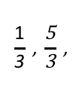
Name: ___________________________ #______ Date: ______________
Post Module 5
Part 2
(3 points) OA.5

Slide 5
Name: ___________________________ #______ Date: ______________
2. At the bottom of this page, create a line plot to display the data in the table. (MD.4)
3. What is the difference in wingspan between the widest and narrowest butterflies on the chart? (NF.3)
Butterfly | Wingspan (inches)
Monarch
Tortoiseshell
Zebra
Viceroy
Postman
Spotted
Julia
Dogface
Tiger
Regal
7
8
3
5
8
2
1
2
2
6
8
2
2
4
3
4. Three butterflies have the same wingspan. Explain how you know the measurements are equal. (NF.2)
2
8
2
2
4
3
3
8
2
1
2
3
4
8
3

